Slide 1
EE2211 Tutorial 10
(remember to sign your attendance on the sheet of paper)

Slide 2
Lecture 9 recap

Slide 3
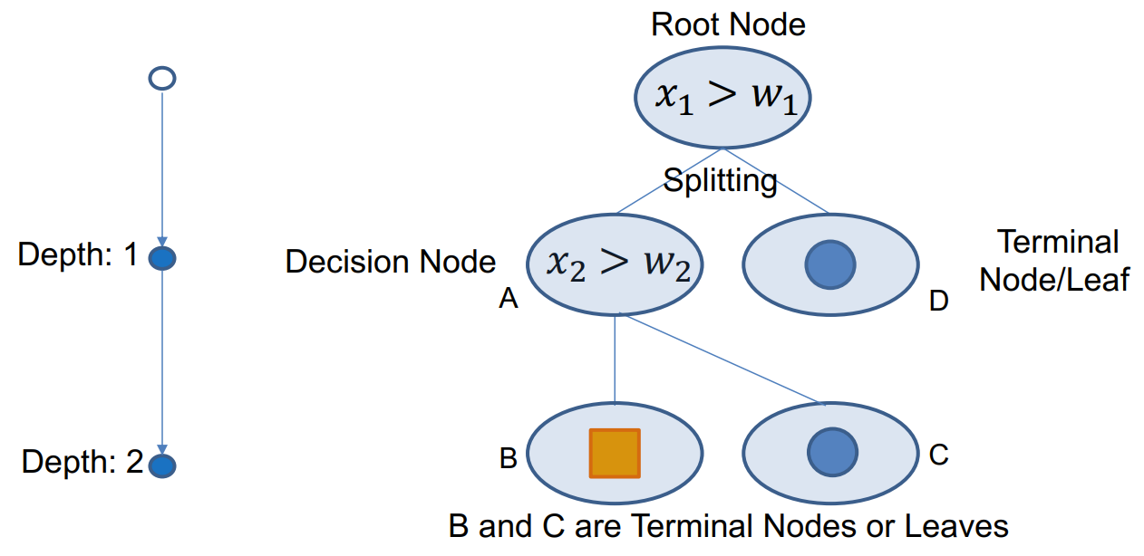
Decision trees

Slide 4
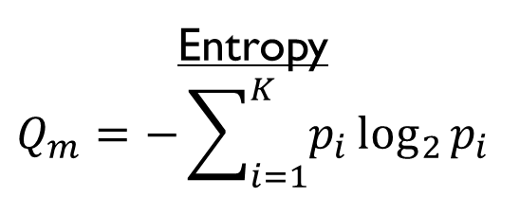
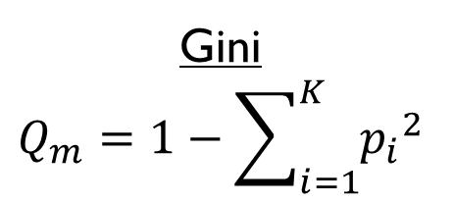
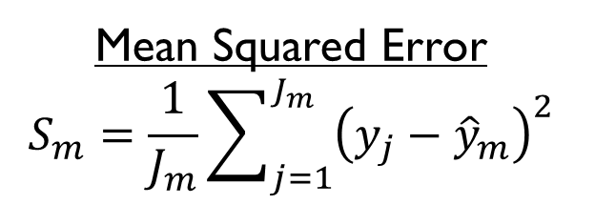
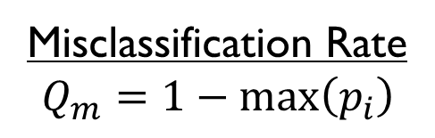
Node impurity and mse
Classification trees
Regression trees
Gini
$$Q_{m}=1−\sum_{i=1}^{K}{{p_{i}}^{2}}$$
Entropy
$$Q_{m}=−\sum_{i=1}^{K}{p_{i}}\log_{2}{p_{i}}$$
Mean Squared Error
$$S_{m}=\frac{1}{J_{m}}\sum_{j=1}^{J_{m}}{{\left(y_{j}−{\hat{y}}_{m}\right)}^{2}}$$
Misclassification Rate
$$Q_{m}=1−\max\left(p_{i}\right)$$

Slide 5
Reduce overfitting and instability in trees
Set maximum depth for the tree
Set minimum number of samples for splitting a leaf node, e.g., if leaf node has less than 10 samples, then do not split node
Set minimum decrease in impurity, e.g., if selecting the best feature & threshold does not improve impurity by at least 1%, then do not split the leaf node
Randomly look at a subset of features
Generate a random forest

Slide 6
Lecture 10 recap

Slide 7
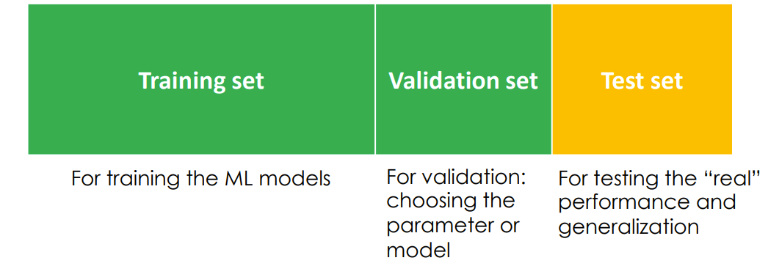
Training, validation, test

Slide 8
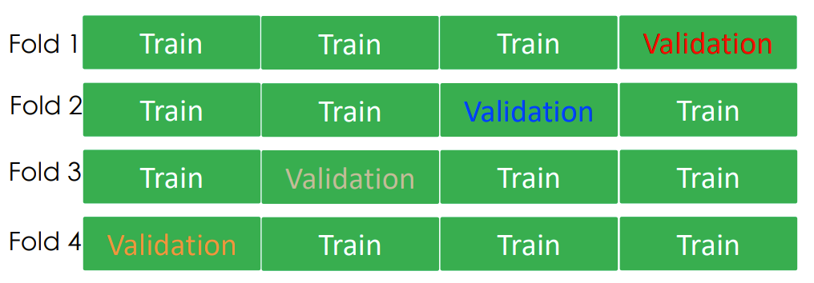
K-fold cross validation
4-fold cross validation

Slide 9
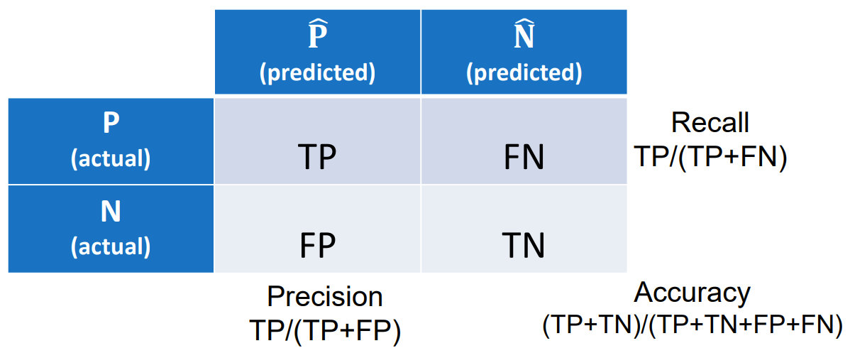
Confusion matrix

Slide 10
Tutorial 10

Slide 11
Question 1
We have two classifiers showing the same accuracy with the same cross-validation. The more complex model (such as a 9th-order polynomial model) is preferred over the simpler one (such as a 2nd-order polynomial model).
True
False

Slide 12
Question 1
We have two classifiers showing the same accuracy with the same cross-validation. The more complex model (such as a 9th-order polynomial model) is preferred over the simpler one (such as a 2nd-order polynomial model).
True
False

Slide 13
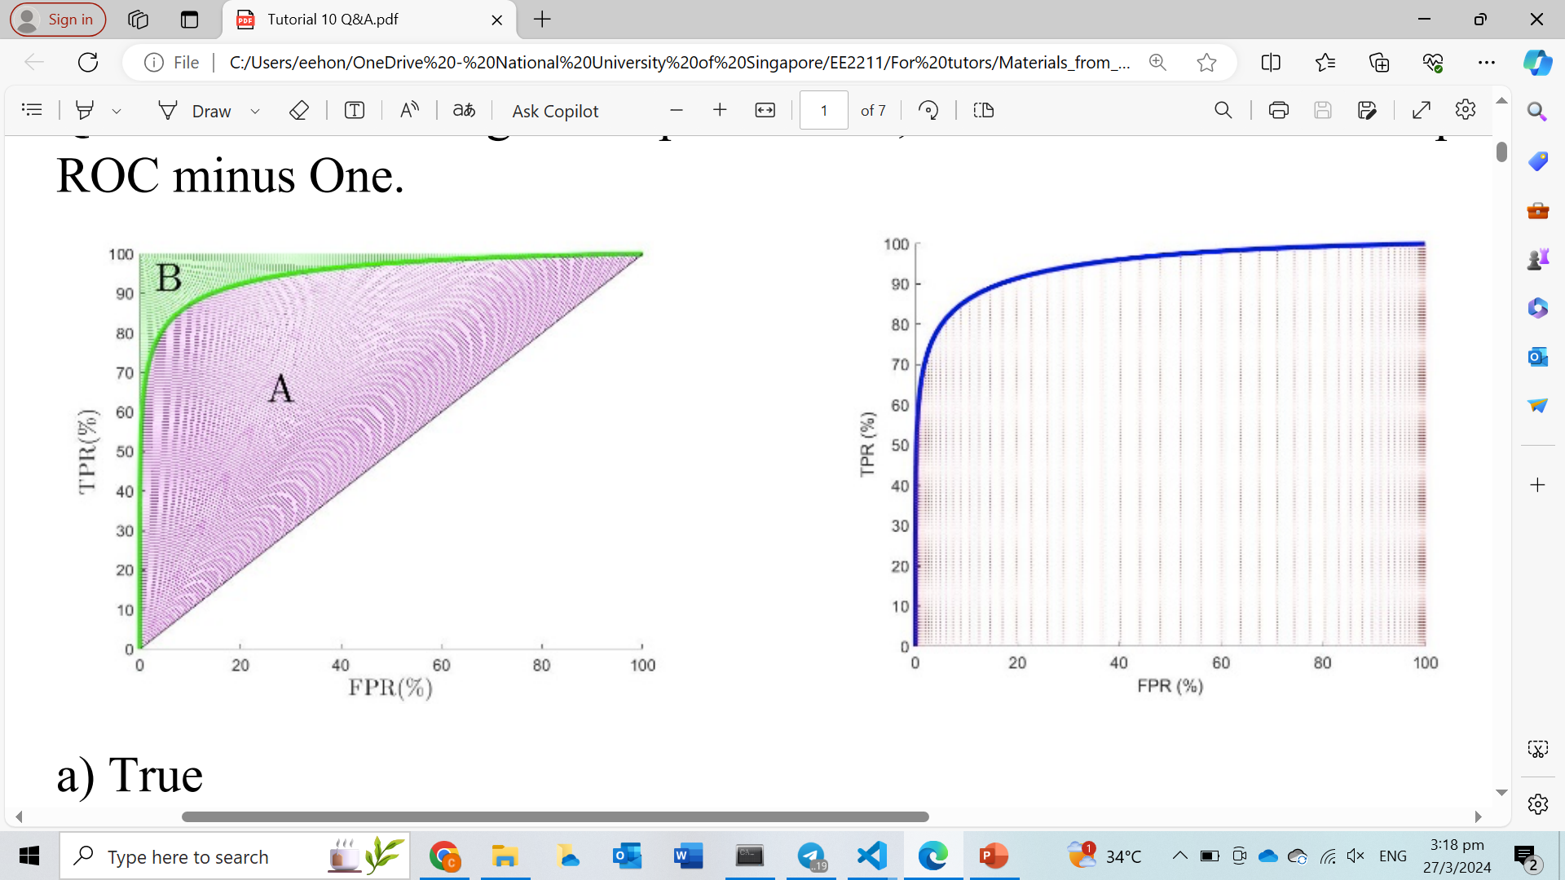
Question 2
According to the plots below, the Gini Coefficient is equal to Two times the Area Under the ROC minus One.
True
False

Slide 14
Question 2
According to the plots below, the Gini Coefficient is equal to Two times the Area Under the ROC minus One.
True
False
Since the area (A+B) = ½ (half the square box of area 1),
Gini-coefficient = A/(A+B) = 2 A. AUC = A+1/2 => A = AUC – 0.5. Substitute A into the Gini above: Gini-coefficient = 2(AUC – 0.5)

Slide 15
Question 3
Suppose the binary classification problem, which you are dealing with, has highly imbalanced classes. The majority class has 99 hundred samples and the minority class has 1 hundred samples. Which of the following metric(s) would you choose for assessing the classification performance?
Classification Accuracy
Cost sensitive accuracy
Precision and recall
None of these

Slide 16
Question 3
Suppose the binary classification problem, which you are dealing with, has highly imbalanced classes. The majority class has 99 hundred samples and the minority class has 1 hundred samples. Which of the following metric(s) would you choose for assessing the classification performance?
Classification Accuracy
Cost sensitive accuracy
Precision and recall
None of these

Slide 17
Question 4
Given below is a scenario for Training error rate Tr, and Validation error rate Va for a machine learning algorithm. You want to choose a hyperparameter (P) based on Tr and Va. Which value of P will you choose based on the above table?
10
9
8
7
6
P | Tr | Va
10 | 0.10 | 0.25
9 | 0.30 | 0.35
8 | 0.22 | 0.15
7 | 0.15 | 0.25
6 | 0.18 | 0.15

Slide 18
Question 4
Given below is a scenario for Training error rate Tr, and Validation error rate Va for a machine learning algorithm. You want to choose a hyperparameter (P) based on Tr and Va. Which value of P will you choose based on the above table?
10
9
8
7
6
P | Tr | Va
10 | 0.10 | 0.25
9 | 0.30 | 0.35
8 | 0.22 | 0.15
7 | 0.15 | 0.25
6 | 0.18 | 0.15

Slide 19
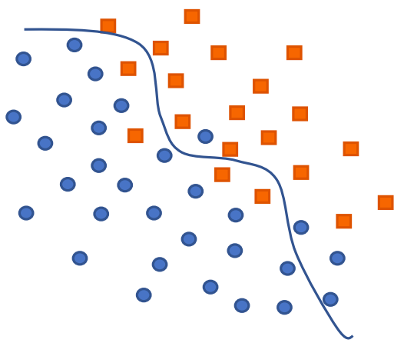
Question 5
Tabulate the confusion matrices for the following classification problems.
Binary problem (the class-1 and class-2 data points are respectively indicated by squares and circles)

Slide 20
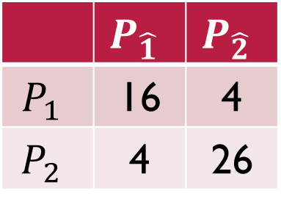
Question 5
Tabulate the confusion matrices for the following classification problems.
Binary problem (the class-1 and class-2 data points are respectively indicated by squares and circles)
 | $$P_{\hat{1}}$$ | $$P_{\hat{2}}$$
$$P_{1}$$ | 16 | 4
$$P_{2}$$ | 4 | 26

Slide 21
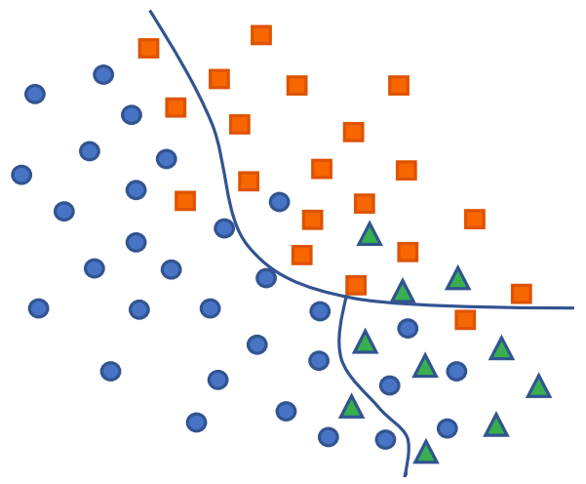
Question 5
Tabulate the confusion matrices for the following classification problems.
Three-category problem (the class-1, class-2 and class-3 data points are respectively indicated by squares, circles and triangles)

Slide 22
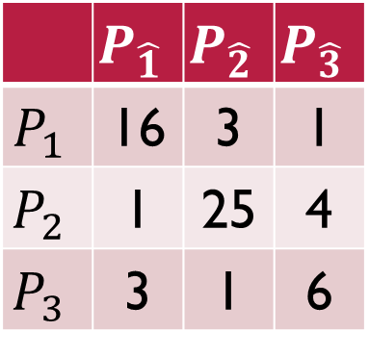
Question 5
Tabulate the confusion matrices for the following classification problems.
Three-category problem (the class-1, class-2 and class-3 data points are respectively indicated by squares, circles and triangles)
 | $$P_{\hat{1}}$$ | $$P_{\hat{2}}$$ | $$P_{\hat{3}}$$
$$P_{1}$$ | 16 | 3 | 1
$$P_{2}$$ | 1 | 25 | 4
$$P_{3}$$ | 3 | 1 | 6

Slide 23
Question 6 (python)
Get the data set “from sklearn.datasets import load_iris”. Perform a 5-fold Cross-validation to observe the best polynomial order (among orders 1 to 10 and without regularization) for validation prediction. Note that, you will have to partition the whole dataset for training/validation/test parts, where the size of validation set is the same as that of test. Provide a plot of the average 5-fold training and validation error rates over the polynomial orders. The randomly partitioned data sets of the 5-fold shall be maintained for reuse in evaluation of future algorithms

Slide 24
Question 7 (python)
Download the spambase data set from the UCI Machine Learning repository. Randomly split the dataset into two parts, 80% for training and 20% for testing. Compute the test Classification Error Rate and the AUC based on the optimal linear regression model without regularization.

Slide 25
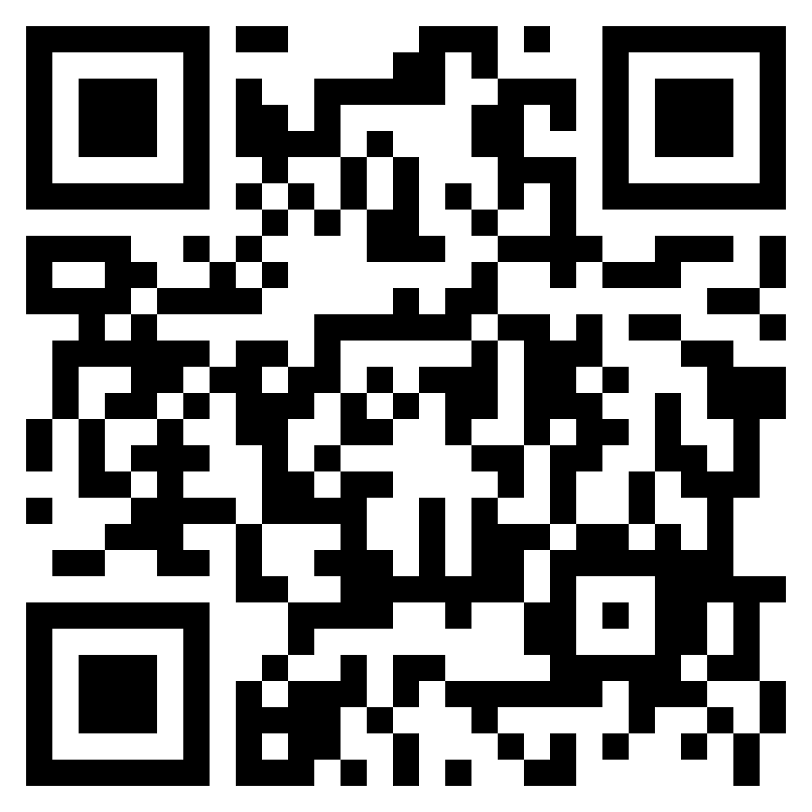

Questions?
Feel free to come up to me if you have any questions about anything!
If you are shy, you can use the anonymous form to leave questions & feedback about the tutorial.
You can also reach out to me on our Telegram group or PM me at @eehongchan
Anonymous feedback
Telegram
https://forms.gle/c9QU94YcWjR3EZFk9

